Slide 1
AMBA BUS ARCHITECHTURE
PARITOSH SAHAY
V.V.KUSUMITHA

Slide 2
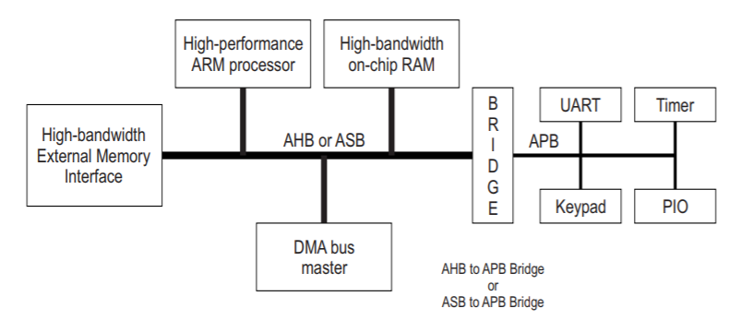
Typical AMBA System

Slide 3
AXI PROTOCOL
AXI Protocol supports high-performance, high-frequency system designs for communication between master and slave components.
AXI protocol supports:
High Bandwidth & low latency designs
High Frequency designs
Backward compatible with APB & AHB protocols
Burst-based transfer

Slide 4
AXI ARCHITECHTURE
AXI protocol defines 5 independent transaction channels:
Write Address (AW)
Write Data (W)
Write Response (B)
Read Address (AR)
Read Data (R)

Slide 5
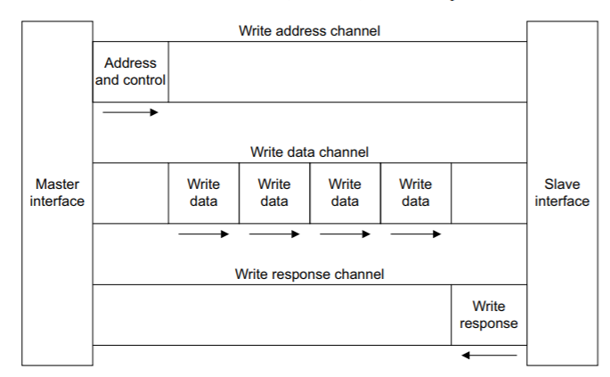
WRITE OPERATION
Fig: Channel Architechture of Writes

Slide 6
SIGNAL DESCRIPTIONS
WRITE ADDRESS | WRITE DATA | WRITE RESPONSE
AWID | WID | BID
AWADDR | WDATA | BRESP
AWLEN | WSTRB | BVALID
AWSIZE | WLAST | BREADY
AWBURST | WVALID
AWVALID | WREADY
AWREADY

Slide 7
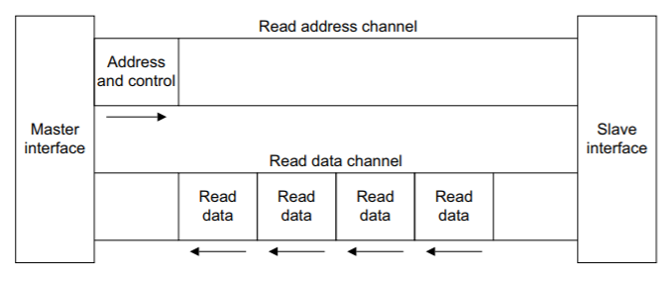
READ OPERATION
Fig: Channel Architechture of Reads

Slide 8
READ SIGNAL DESCRIPTIONS
READ ADDRESS | READ DATA
ARID | RID
ARADDR | RDATA
ARLEN | RRESP
ARSIZE | RLAST
ARBURST | RVALID
AVALID | RREADY
AREADY

Slide 9
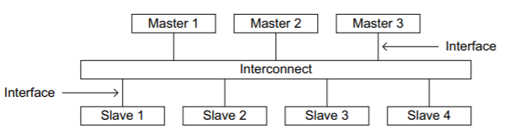
INTERFACE & INTERCONNECT
AXI Protocol provides interface between :
A Master & the interconnect
A Slave & the interconnect
A Master & a slave

Slide 10

DATA TRANSFER THROUGH FIFO USING AXI PROTOCOL
MASTER
FIFO
SLAVE
Performing Data communication from master & slave i.e Write to slave & Read from slave

Slide 11
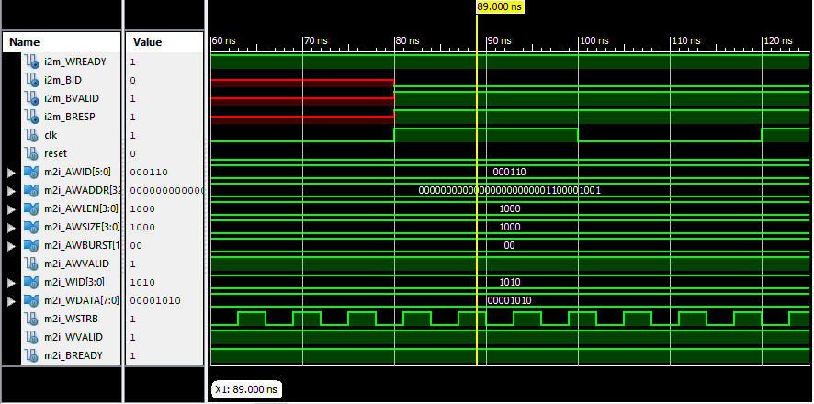
Waveforms for write channel

Slide 12
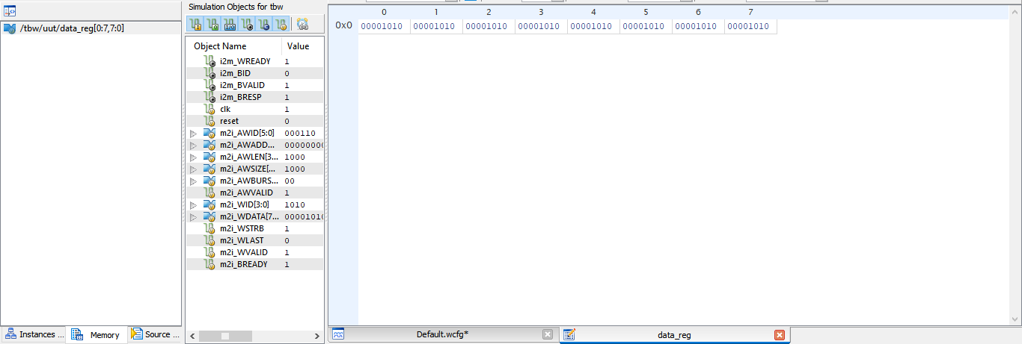
Written data

Slide 13
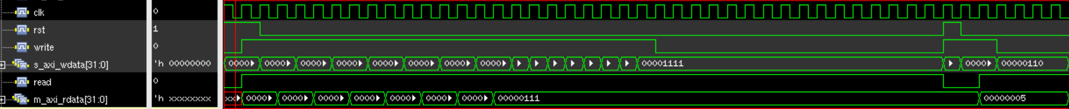
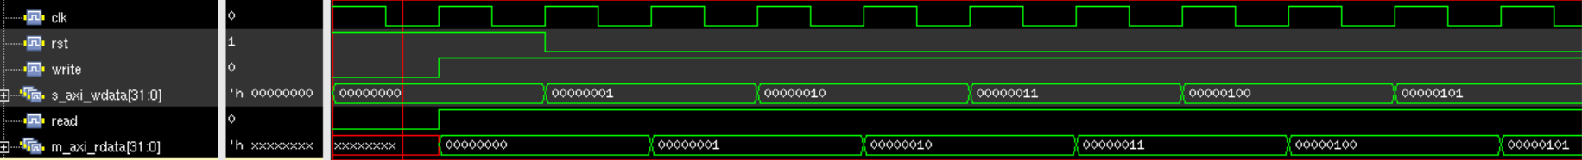
Fig : Simulation waveforms for Read

Slide 14
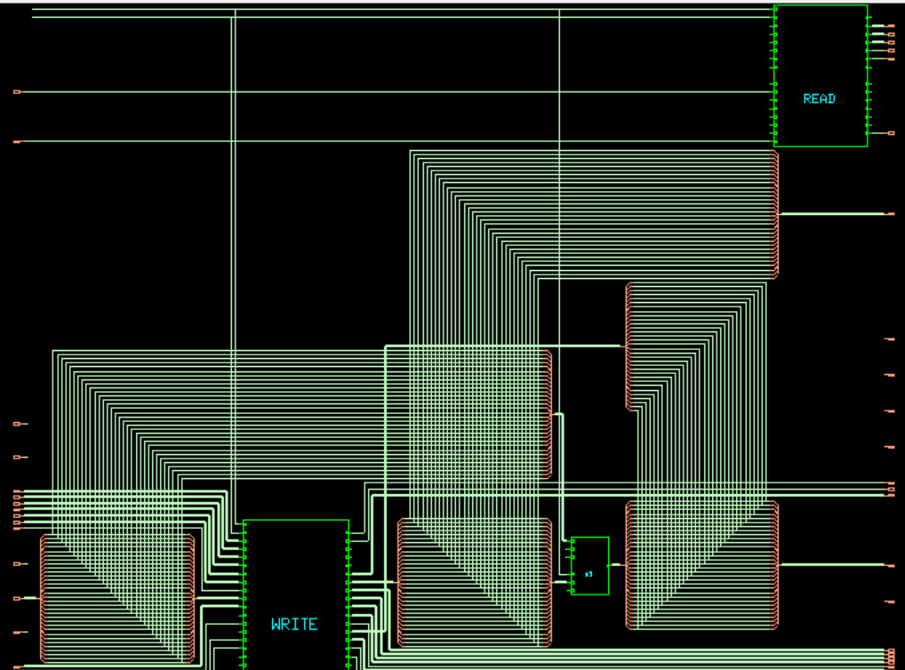

Slide 15
Variants of AXI Protocol
AXI STREAM
AXI Memory mapped
AXI Lite

Slide 16
THANK YOU…!!

Slide 17

Designer helps you get your point across
PowerPoint Designer suggests professional designs for your presentation, based on the content in your slides.
Designer is a subscription-only feature. If you have an Office 365 subscription, the next slide shows you how it works in a new presentation.

Slide 18
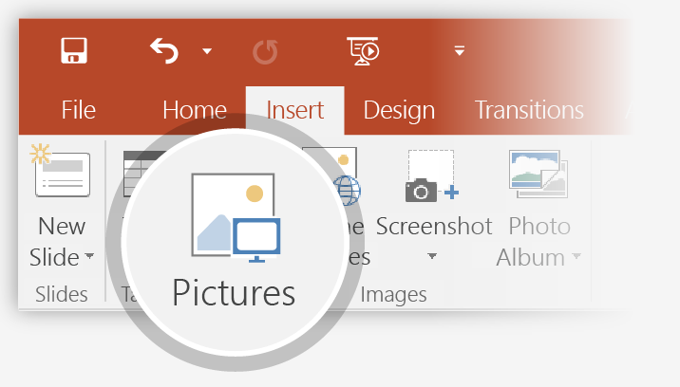
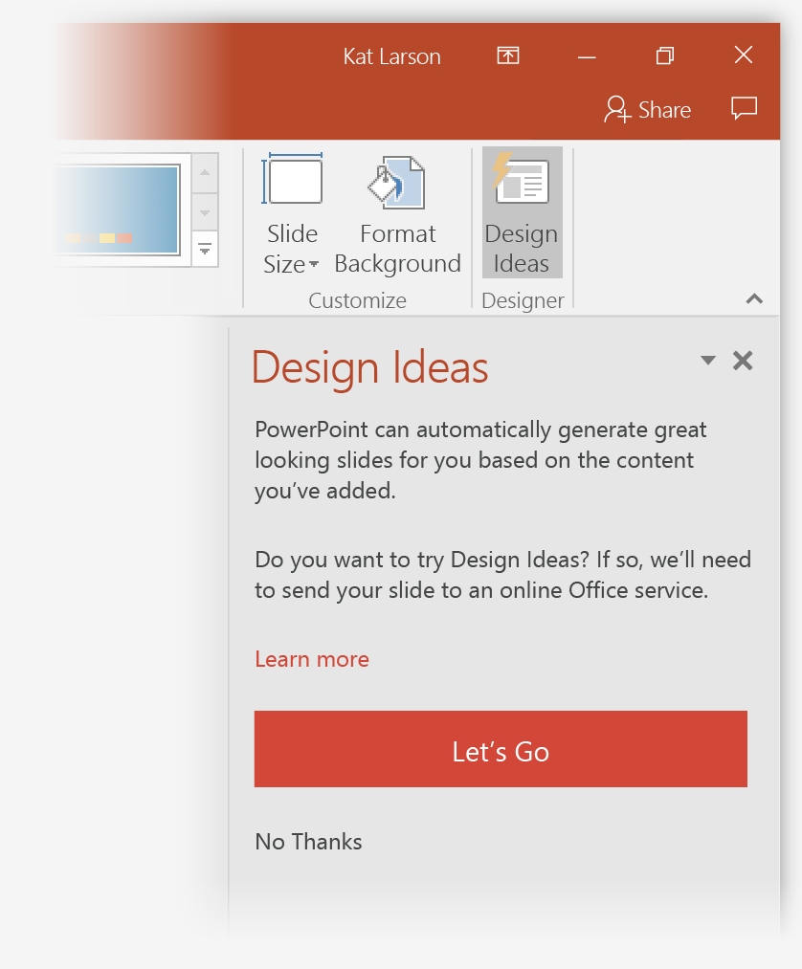
How to use PowerPoint Designer
How it works:
1
Start a new presentation by going to File > New > Blank Presentation.
2
On the very first slide, add a picture: Go to Insert > Pictures or Insert > Online Pictures and choose the picture. Hint: You need to be online when you add the picture.
3
When PowerPoint asks your permission to get design ideas, select Let's Go.
4
Choose a design you like from the Design Ideas task pane.

Slide 19
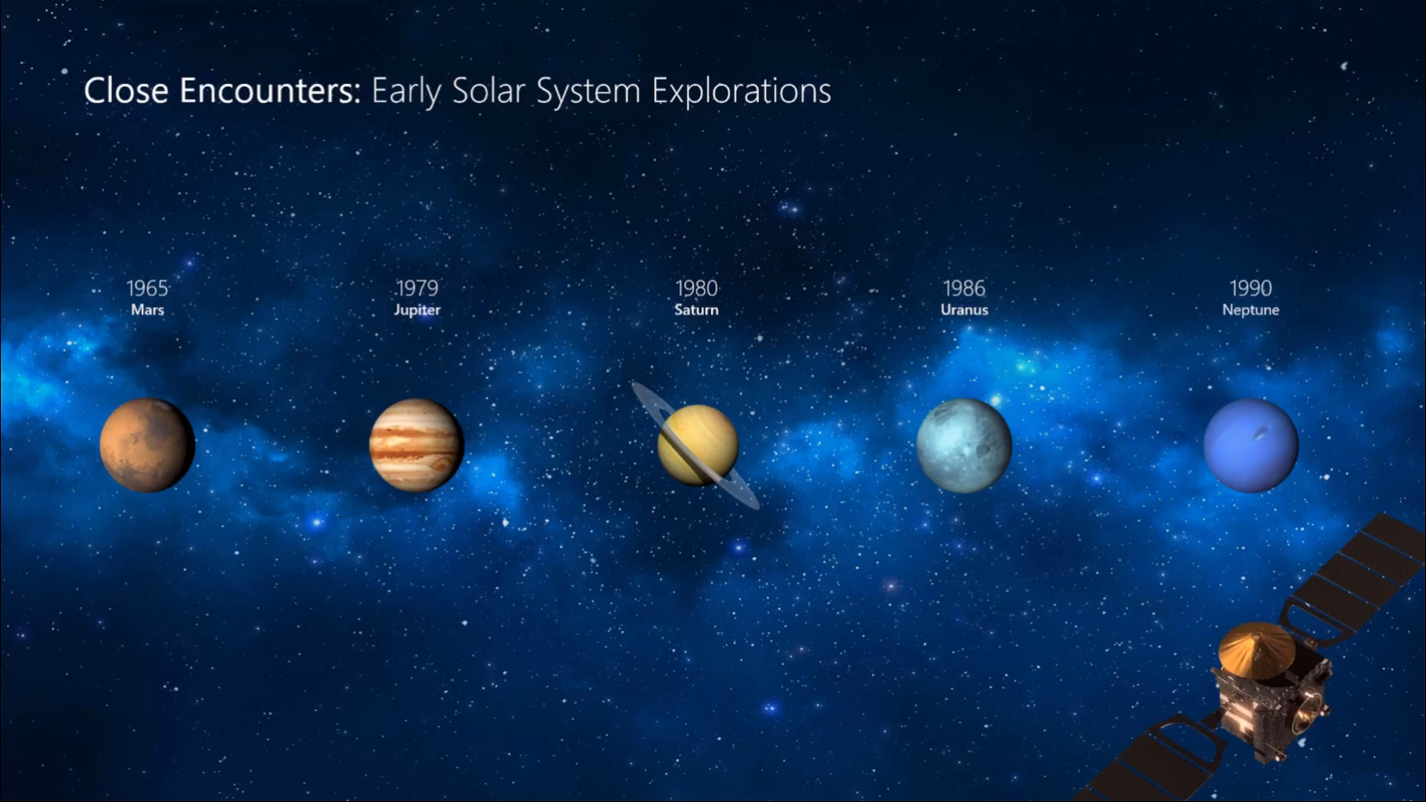
Morph
Morph makes smooth animations and object movements in your presentation. You use two similar slides to perform the animation, but it looks to your audience like the action happens on one slide.
Play the video on the right to see a quick example.
Morph is a subscription-only feature. If you have an Office 365 subscription, you can try it yourself with the steps on the next slide.

Slide 20
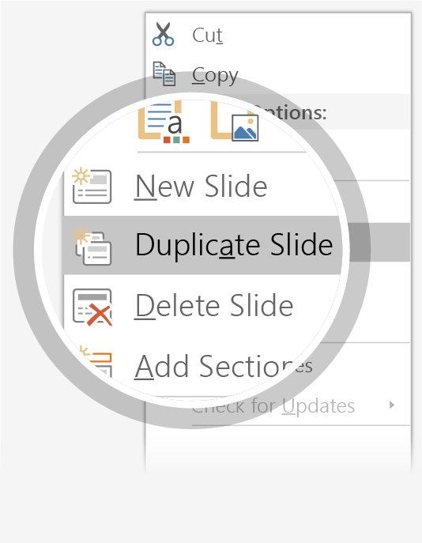
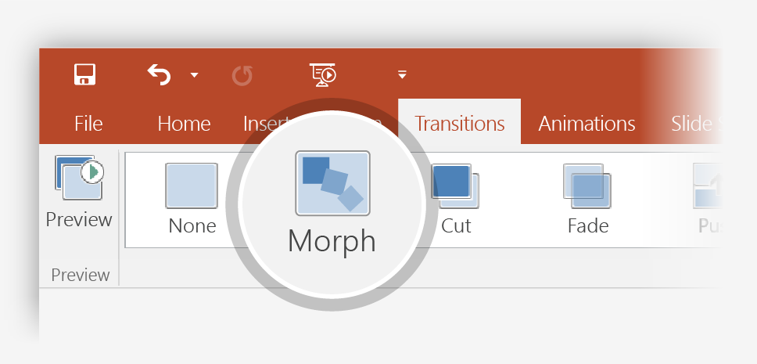

Setting up Morph
Try it yourself with these two simple “planets”:
1
Duplicate this slide: Right-click the slide thumbnail and select Duplicate Slide.
2
In the second of these two identical slides, change the shapes on the right in some way (move, resize, change color), then go to Transitions > Morph.
3
Return to the first of the two slides and press Slide Show button and then select Play to see your circle morph!
Hint: Effect Options gives you even more options for Morph.

Slide 21
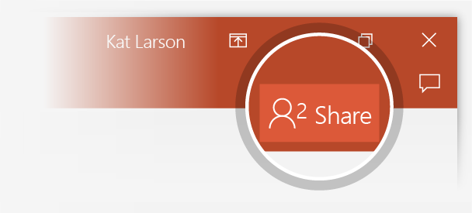
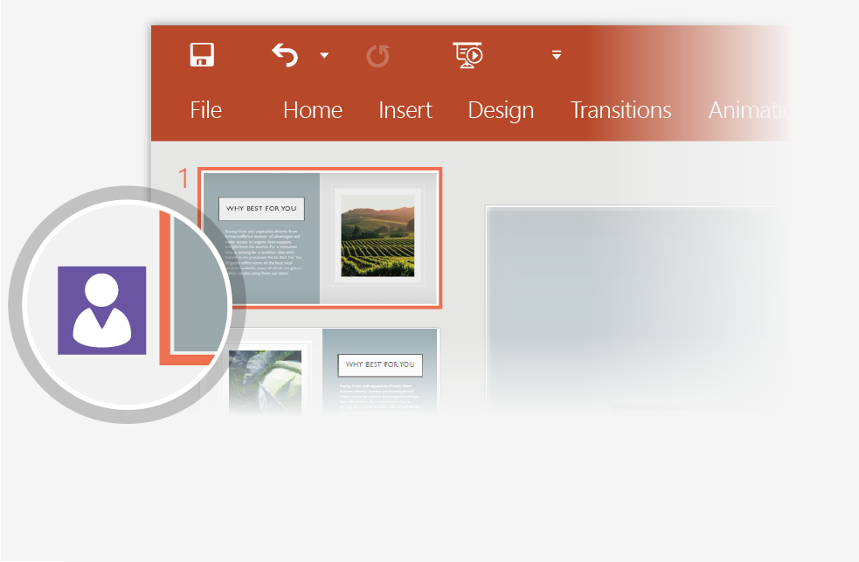
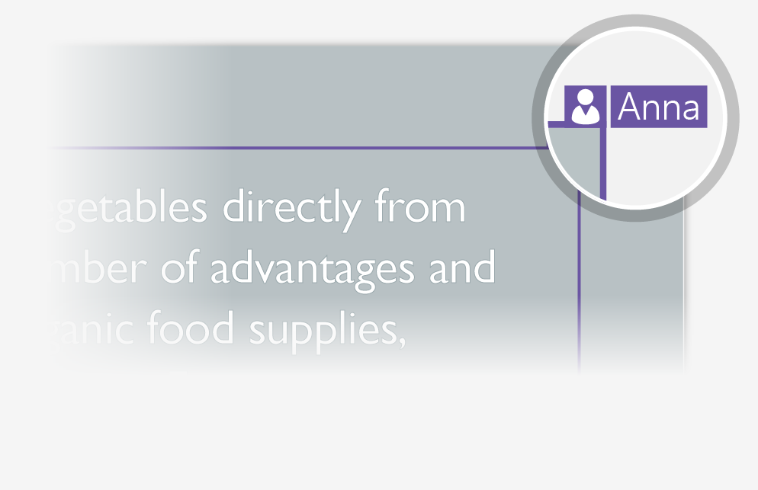
Working together in real time
When you share your presentation with others, you’ll see them working with you at the same time. How it works:
1
Select Share from above the ribbon, or by using short-key Alt-YU, to invite people to work with you (You can save to the cloud at this point.)
2
When other people are in the presentation, a marker shows who is on which slide…
3
…and the part of the slide they're editing.

Slide 22


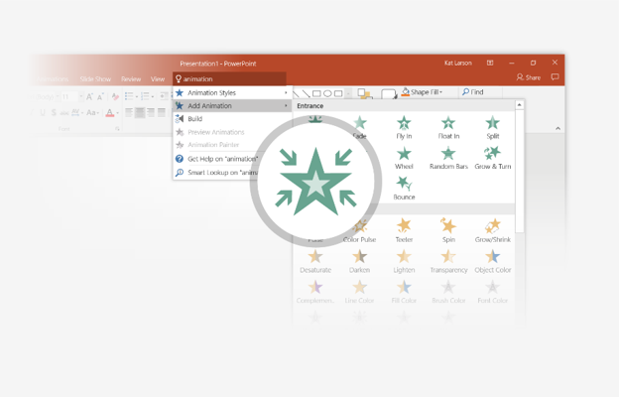
You’re an expert with Tell Me
The Tell Me box finds the right command when you need it, so you can save time and focus on your work. Try it:
SELECT ME
1
Select the Robot picture on the right.
2
Type animation in the Tell Me box, and then choose Add Animation.
3
Choose an animation effect, like Zoom, and watch what happens.

Slide 23
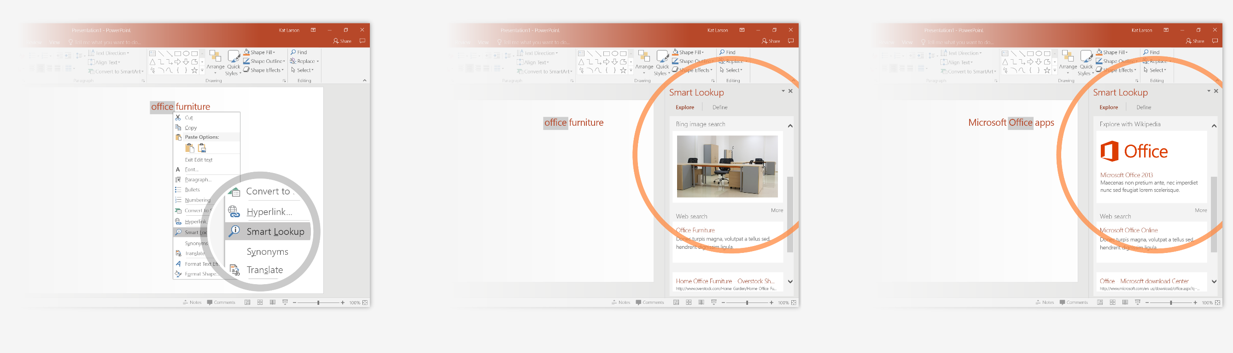
Explore without leaving your slides
Smart Lookup brings research directly in to PowerPoint. Try it:
1
Right-click in the word office in the following phrase: office furniture
2
Choose Smart Lookup, and notice that results are contextual for that phrase, not Microsoft Office apps.
3
Just for fun, try Smart Lookup again by right-clicking in the word Office in Step 2.

Slide 24

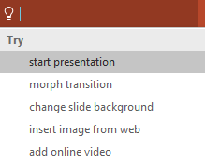

More questions about PowerPoint?
Select the Tell Me button and type what you want to know.
Visit the PowerPoint team blog
Go to free PowerPoint training
Give feedback about this tour
SELECT THE ARROW WHEN IN SLIDE SHOW MODE
Notes:
In Slide Show mode, select the arrows to visit links.

